Slide 1


CIS 600 – Social Media and Data Mining
01
Analyzing Public Perception and Engagement with Climate Change on Reddit
Project Members:
Atharva Kulkarni
Nimeesh Bagwe
Yogesh Patil
Rahul Pudurkar
Divit Shetty

Slide 2

Index
02
•Project Background
•Problem Statement
•Dataset Snapshot
•Project Objectives/ features
Identify Popular Keywords
Sentiment Analysis
Misinformation Detection
Identify the Most Influential Comments
Subreddit Popularity Analysis
Word Cloud
•Conclusion

Slide 3


03
Project Background​
Climate change stands as one of the defining challenges of our era, impacting communities globally. To comprehend how the public perceives and engages with this critical issue, our research targets the dynamic landscape of climate change discussions on Reddit. Through advanced Natural Language Processing (NLP), we aim to delve into the sentiments, narratives, and influential voices within these online conversations. As the effects of climate change reverberate worldwide, this project strives to offer nuanced insights into public perspectives, ultimately contributing to data-driven solutions for this pressing global concern. on, addressing critical challenges related to data privacy, real-time processing, and efficiency improvement, while ensuring seamless integration into existing AV systems and reliable operation in diverse automotive environments.​

Slide 4
Problem Statement
04
Global Challenge: Climate change demands urgent solutions.​
Social Media Role: Key in understanding public views and engagement.​
Research Objective: Analyze Reddit's climate change discussions.​
Focus Areas​
Identify key topics and attitudes.​
Analyze user interactions and engagement.​
Actionable Insights: Guide effective climate change strategies for policymakers, organizations, and researchers.

Slide 5
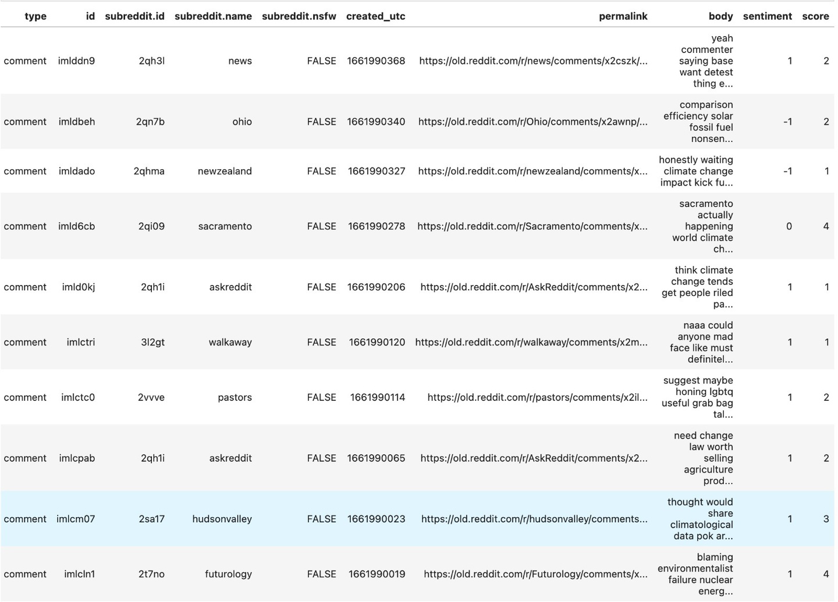
DATASET SNIPPET
05

Slide 6
Identify Popular Keywords
TF-IDF Overview:(Term Frequency-Inverse Document Frequency.)
Importance of a word in a document .
Conversion of Text to TF-IDF Matrix:
TfidfVectorizer from scikit-learn .
Feature Retrieval:
Retrieves the feature names (terms) present in the TF-IDF matrix.
Identification of Top Features:
Calculates the sum of TF-IDF values for each term across all documents.
Identifies the indices of the top 10 features based on these sums.

Slide 7
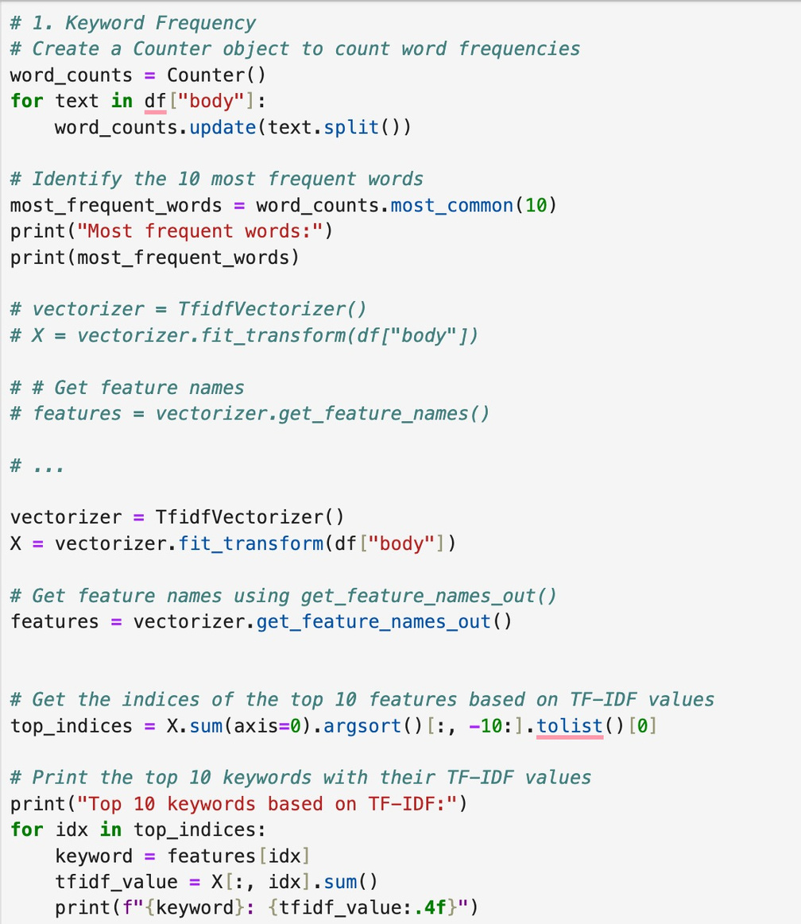
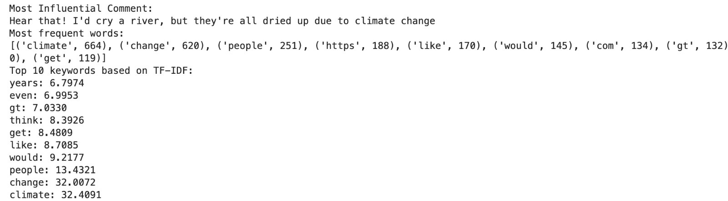
Code:
Output:

Slide 8
Key Outcomes
Term Importance:
Higher TF-IDF: A higher value indicates that the term is more important in that document relative to the entire corpus.
Top Keywords:
Keyword Importance: These top terms are considered the most important keywords in the corpus..
Thresholds and Filters:
Setting Thresholds: You can set thresholds to filter out terms with low TF-IDF values, focusing on the most significant terms.
Customized Analysis: Helps in customizing the analysis based on your specific criteria and objectives.
Application: Information Retrieval (Search Engines), Content Recommendations.

Slide 9

03
SENTIMENT ANALYSIS
What is Sentiment Analysis?
Sentiment analysis is the automated process of gauging opinions and emotions expressed in text to determine if they are positive, negative, or neutral.
Uses of Sentiment Analysis
Opinion Insights
Community Engagement
Sentiment Trends
Decision Support
Brand Perception
Issue Awareness

Slide 10
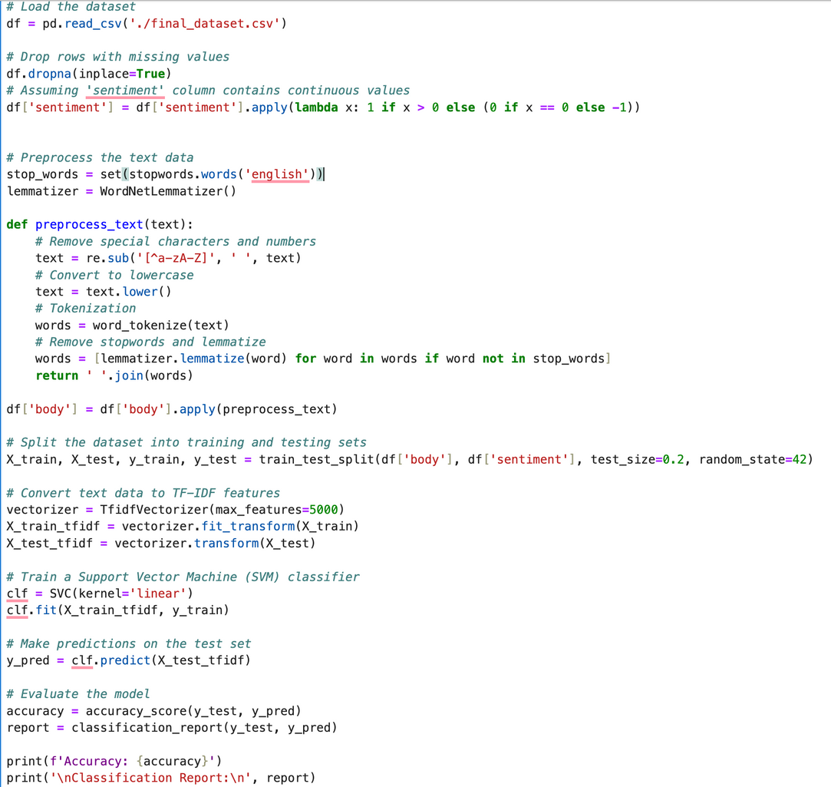
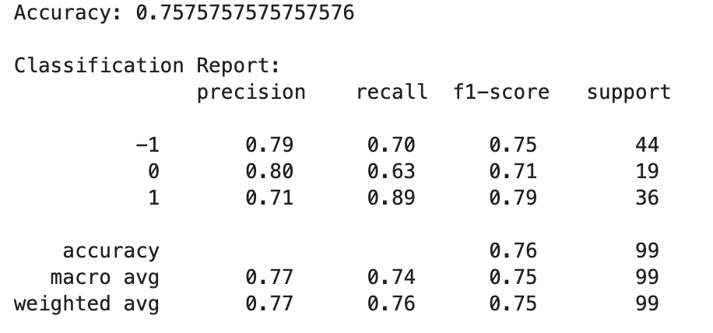
SENTIMENT ANALYSIS - TRAINING
05
Code:
Output:

Slide 11
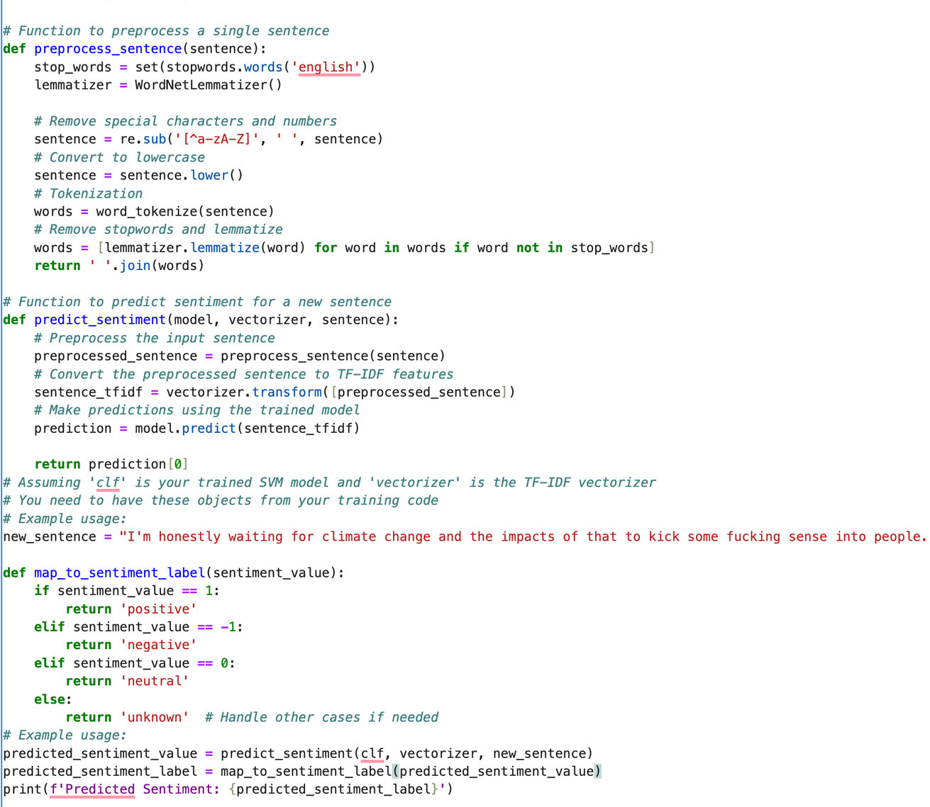
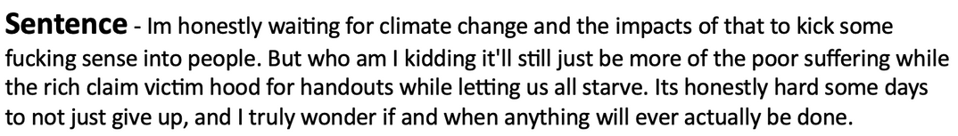
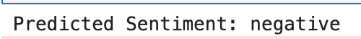
SENTIMENT ANALYSIS PREDICTION
Code:
Sentence:
Output:

Slide 12
MISINFORMATION PREDICTION - USES
05
Community Moderation:
Predicting and identifying climate change misinformation in Reddit comments to assist community moderators in maintaining accurate and reliable information within climate-related discussions.
Educational Outreach:
Utilizing misinformation prediction to target and correct false information in Reddit comments, particularly in educational or informational threads, enhances the overall quality of climate change discussions.
Algorithmic Content Filtering:
Integrating misinformation prediction into algorithms that filter and rank Reddit comments, helping to reduce the visibility of misleading information and promote more accurate content.

Slide 13
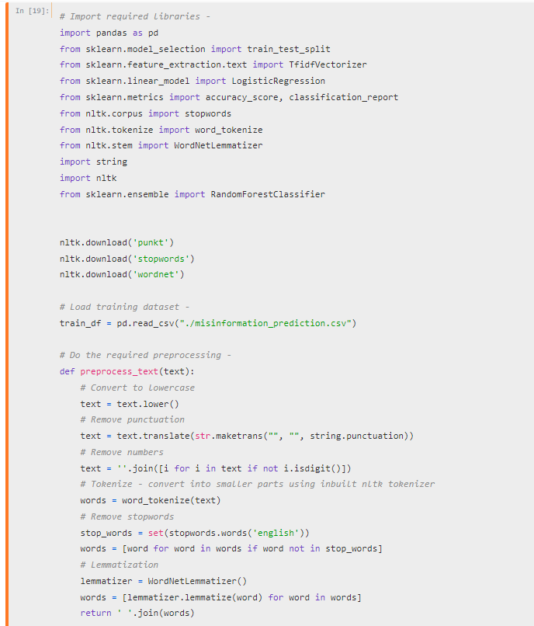
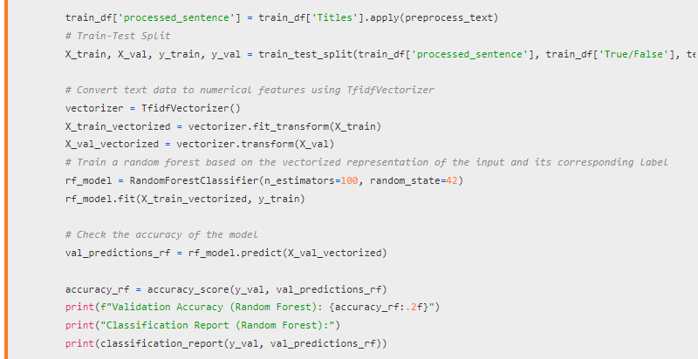
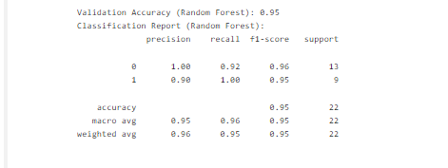
MISINFORMATION PREDICTION - TRAINING
05

Slide 14
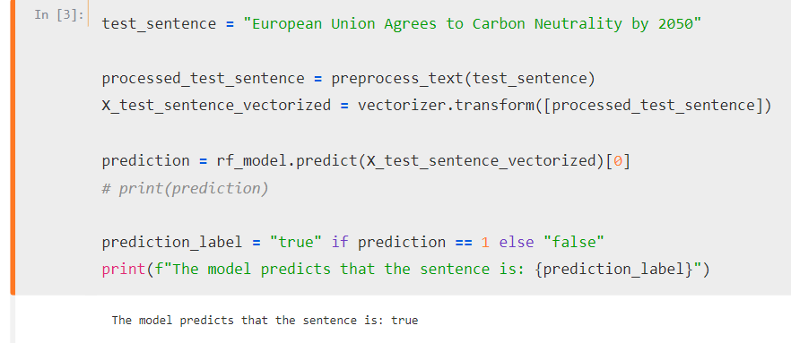
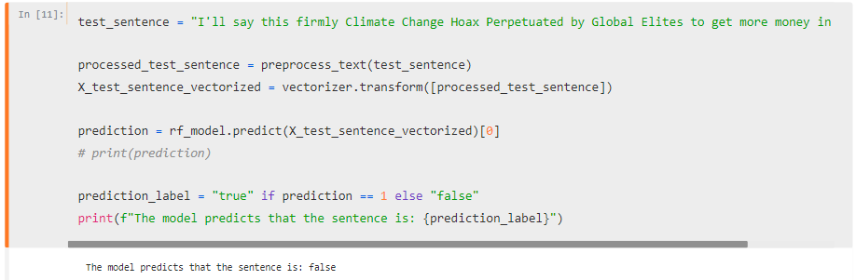
MISINFORMATION PREDICTION - OUTPUT
05

Slide 15
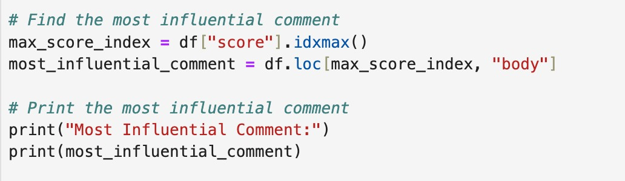
Most Influential Comment
Stopwords:
Stopwords are common, non-informative words (e.g., "the," "and") removed during text analysis to focus on more meaningful content words
Score Analysis:
Score is calculated based on the number of upvotes and downvotes for each comment.
Identifies the index of the row with the maximum value in the "score" column
Output:

Slide 16
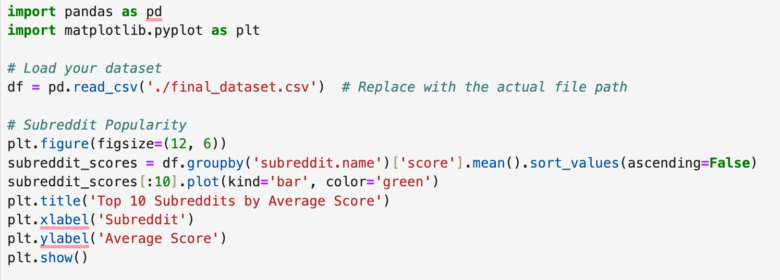
Subreddit Popularity Analysis
Created a bar chart to visualize the top 10 subreddits based on the average score of their posts
Grouped the DataFrame 'df' by the 'subreddit.name' column and calculates the mean score for each subreddit
Sorted the subreddits in descending order based on the average score
Selected the top 10 subreddits and plots them as a bar chart in green

Slide 17
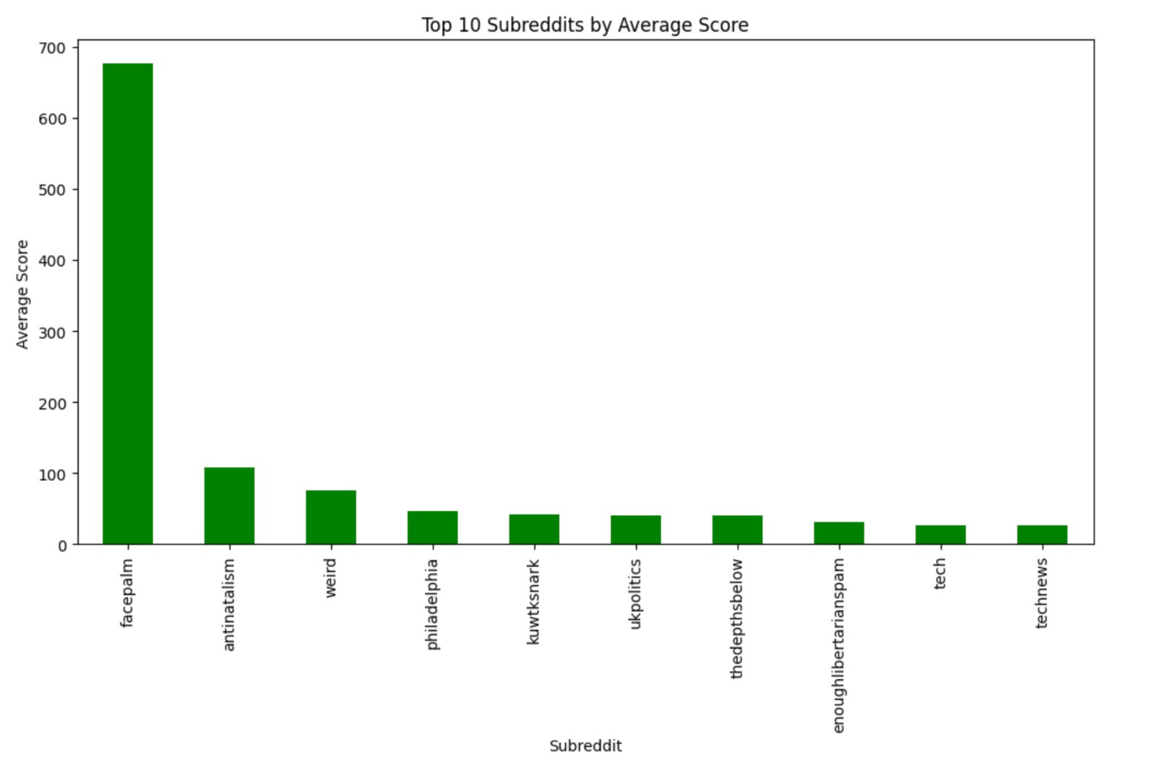
Subreddit Popularity Analysis
Output:

Slide 18
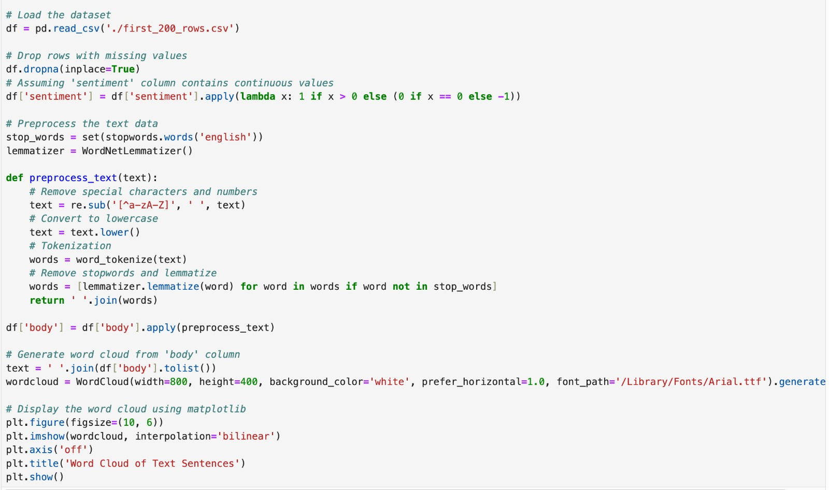
Word Cloud of Text Sentences
Word Cloud: Visual representation of text where words are sized based on their frequency
Word Size: Larger words indicate higher frequency in the given text
Layout: Words are arranged in an aesthetically pleasing and often random manner
Color: Words may be displayed in various colors for visual appeal
Usage: Commonly used in data exploration, sentiment analysis, and summarization of text data

Slide 19
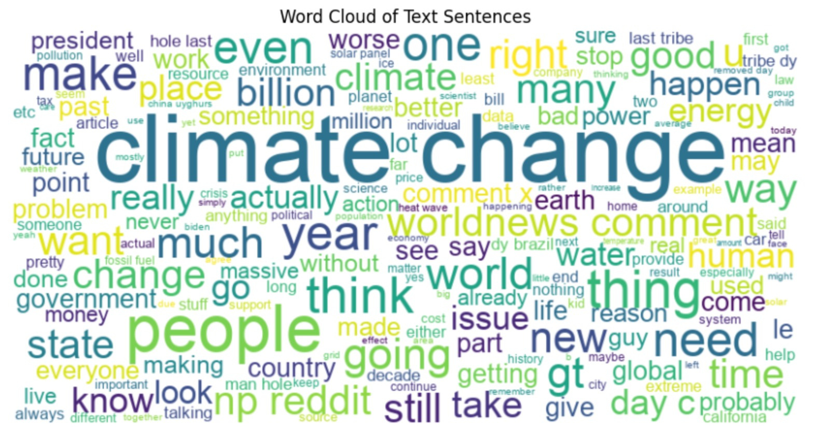
Word Cloud of Text Sentences
Output:

Slide 20
CONCLUSION
07
Our project delves into Reddit conversations on climate change, employing advanced tools to grasp public sentiments, tackle misinformation, and empower policymakers and researchers with data-driven strategies—a step toward fostering a more informed and engaged public in the face of the global challenge that is climate change.

Slide 21


Thank You!

